Slide 1
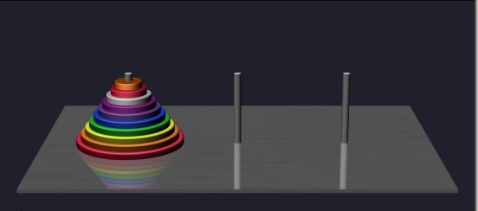
The towers of hanoi
An awesome example of the power of recursion.

Slide 2
The Tower of Hanoi Story
Taken From W.W. Rouse Ball & H.S.M. Coxeter, Mathematical Recreations and Essays, 12th edition. Univ. of Toronto Press, 1974.
The De Parville account of the origen from La Nature, Paris, 1884, part I, pp. 285-286.
In the great temple at Benares beneath the dome that marks the centre of the world, rests a brass plate in which are fixed three diamond needles, each a cubit high and as thick as the body of a bee. On one of these needles, at the creation, God place sixty-four discs of pure gold, the largest disk resting on the brass plate, and the others getting smaller and smaller up to the top one. This is the tower of Bramah. Day and night unceasingly the priests transfer the discs from one diamond needle to another according to the fixed and immutable laws of Bramah, which require that the priest on duty must not move more than one disc at a time and that he must place this disc on a needle so that there is no smaller disc below it. When the sixty-four discs shall have been thus transferred from the needle which at creation God placed them to one of the other needles, tower, temple, and Brahmins alike will crumble into dust and with a thunderclap the world will vanish.
The number of separate transfers of single discs which the Brahmins must make to effect the transfer of the tower is two raised to the sixty-fourth power minus 1 or 18,446,744,073,709,551,615 moves. Even if the priests move one disk every second, it would take more than 500 billion years to relocate the initial tower of 64 disks.
http://www.rci.rutgers.edu/~cfs/305_html/ProblemSolving_Planning/ProblemSolving_toc.html

Slide 3
Problem Statement
You are given three posts and n disks of varying sizes. Initially, all the disks are stacked on a designated “start” post. The disks are stacked so that the largest disk is on the bottom, followed by the second largest disk, all the way up to the smallest disk which is placed on the top of the stack. The goal is to move this stack of disks from the “start” post to a designated “finish” post subject to the following constraints:
You may only move one disk at a time.
You may only move the top disk on a post.
You may never place a larger disk on top of a smaller disk.

Slide 4
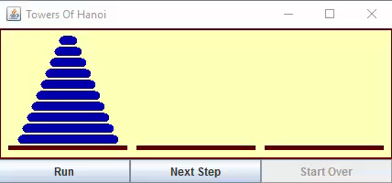

Slide 5
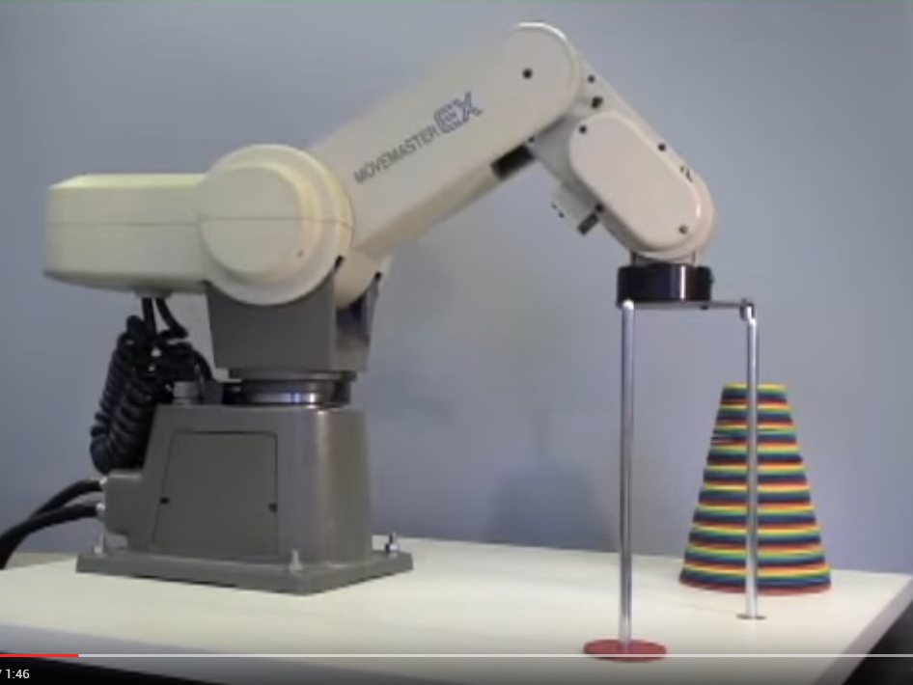
https://www.youtube.com/watch?v=h8JPtWpctl4
51 disks
1 move/second
71.4 million years to finish

Slide 6
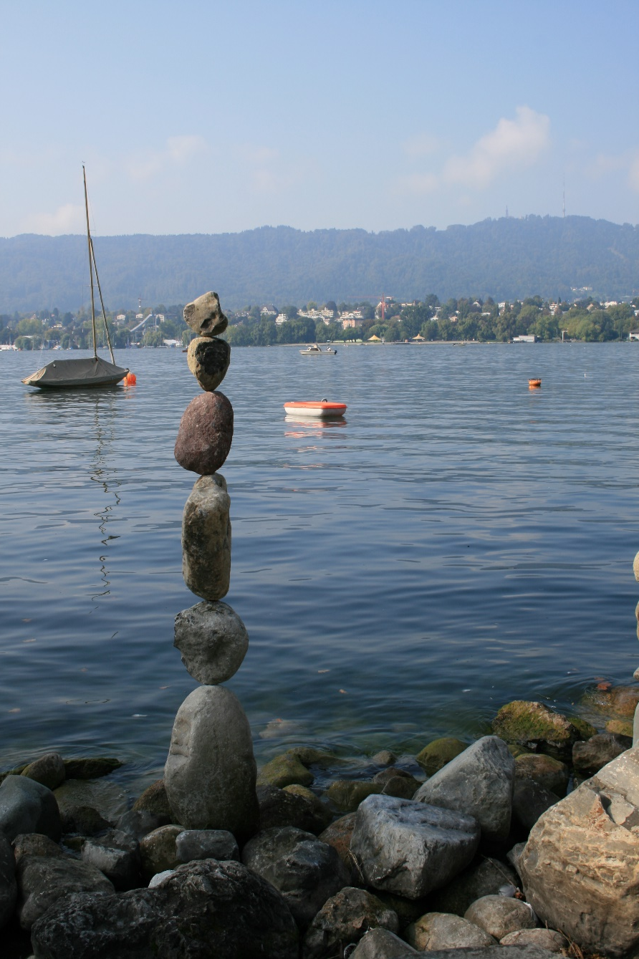

Slide 7
Problem: Write an SML function that solves the towers of Hanoi.
A call to move 3 disks from post 1 to post 2 would be: solve(3,1,2,3);
1
2
3
How do we recursively decompose this problem?
Analysis: If we had an “assistant” that could move the first n-1 disks from the start post to the spare post, then we could simply move disk n from the start post to the finish post, and then again ask our assistant to move the n-1 disks from the spare post to the finish post.

Slide 8
fun printMove(disk,post1,post2) =
print(“Move disk ” ^ Int.toString disk ^
“ from post ” ^ Int.toString post1 ^
“ to post ” ^ Int.toString post2 ^ “\n”);
fun solve(n,start,finish,spare) =
if n = 1 then printMove(n,start,finish)
else (
solve(n-1,start,spare,finish);
printMove(n,start,finish);
solve(n-1,spare,finish,start)
);
solve(3, 1, 2, 3);

Slide 9
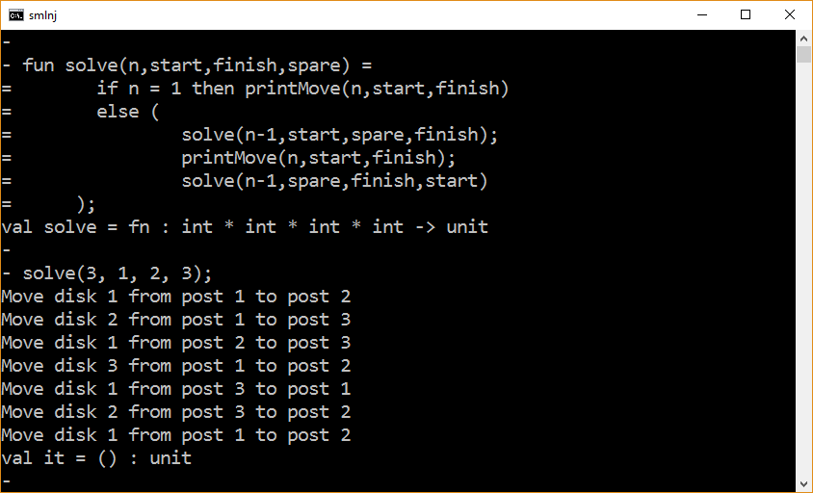

Slide 10
The end

